Slide 1
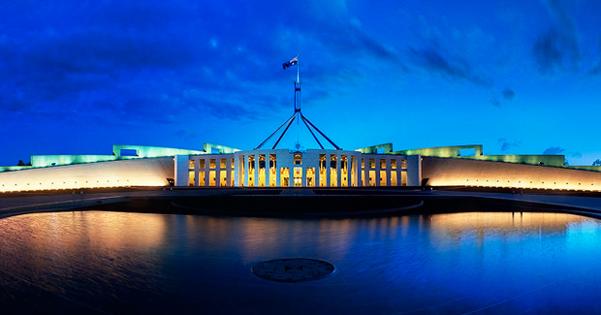
PARLIAMENT AND THE LAW
Chapter 5

Slide 2
SYLLABUS DOT POINT (EXAMINABLE MATERIAL)
Types of law made by parliament and subordinate authorities
Legislative process and the Commonwealth level

Slide 3

To start…

Slide 4

WHAT ARE LAWS?
Laws control matters of human activity (trivial to profound)
Name 10 laws with person next to you (i.e. age legal to drive)
The law is the most powerful social controller and regulator of all
The law aims to reflect the desires of the community
Why do we comply with the law?
Social values:
Respect for the law
Respect for life (i.e. murder)
Equality (UN Decl of HR)
Freedom
Protection of the weak

Slide 5
WHAT ARE LAWS?
What is the difference between rules and laws?
Rules also regulate behaviour, some are practical and technical (driving on left side), other affect behaviour unconsciously i.e. raise hand in class
Some rules would be difficult to enact as laws
However, some rules are also laws – how can you know?
A law is enforceable by the courts
Laws have been determined by Parliament in statutes, or contained in common law based on court cases

Slide 6
WHAT ARE LAWS?
Laws also have jurisdiction (where the law speaks). There are 2 types:
Geographical jurisdiction (the land and sea the laws apply). In Australia there are federal laws which apply to the whole country and State laws that apply to subnational regions.
Note: exclusive, concurrent and residual powers
2. Legal jurisdiction is the area of law that is covered. Family laws over family matters (marriage, divorce etc). Trade laws cover imports and exports, tariffs, taxes etc.

Slide 7
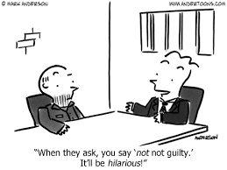
WHAT ARE LAWS?
Laws are formal behavioural codes and have 4 qualities:
Laws are applicable to a whole population
Laws are applicable to a geographical jurisdiction
Laws are applicable all the time; and
Laws are backed by sanctions decided by the legislative arm, enforced by the executive arm and adjudicated by the judicial arm. Sanctions may include the lawful suspension of an individuals rights

Slide 8
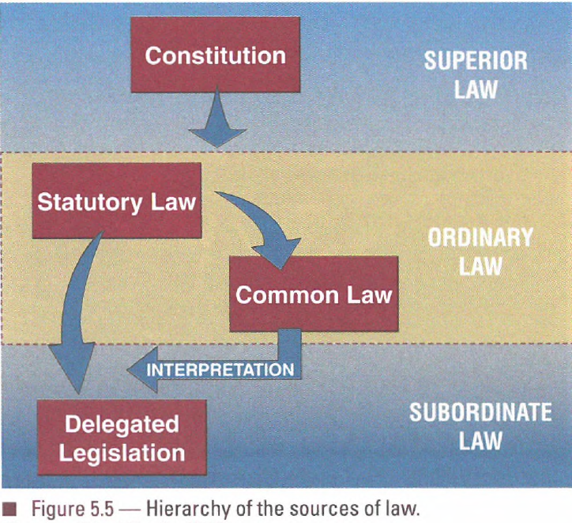
Types of law
Constitutional law
Statute law/legislation (made by Parliament)
Common law (made by judges)
Delegated legislation (made by subordinate authorities)

Slide 9
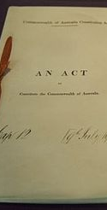
1. Constitutional law
This is superior law or fundamental law
Constitutional law:
Establishes the geographical and legal jurisdiction of power
Creates 3 arms of government
Specified the processes of government
Protects fundamental rights
Codifies procedures for constitutional change
Constitutional law is above and beyond parliaments and courts
Read page 88 (stop at Ordinary law)

Slide 10

QUESTIONS…
Answer Q1 a, b and c - Ch.5

Slide 11
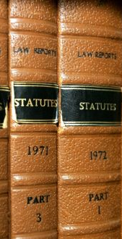
2. statute law
Read page 92 - 94
Parliament makes STATUTE laws
Statute is the name given to an Act of Parliament
An Act of Parliament is also known as legislation
Why?
Created by a legislature (a body who makes laws/legislate for citizens)
The Legislature is also referred to as Parliament
The process of creating statute law/legislation/Acts of Parliament follows the same procedure
https://www.youtube.com/watch?v=5tkrJ3Tj8Ho

Slide 12
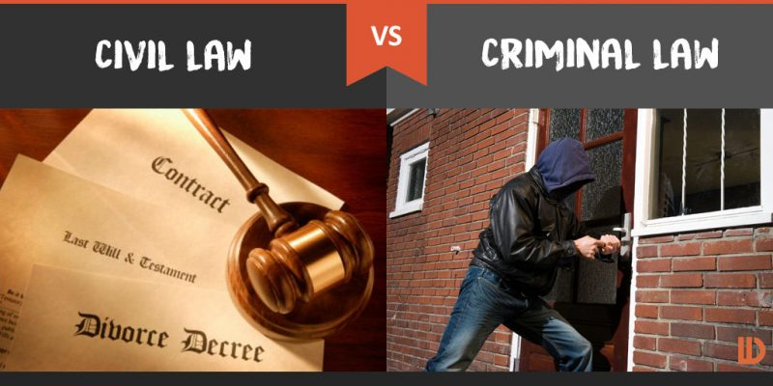
2. statute law
Criminal law:
Apply to the conduct of the whole of society
Best known example of public law
Alleged breaches of criminal law are investigated by the police on behalf of public
May be pursued through the courts (prosecution)
Civil law:
Laws that regulate conduct of individuals with other individuals
Resolved privately without involving government or the police
Major examples of civil law: Contract law and Tort law (negligence)

Slide 13
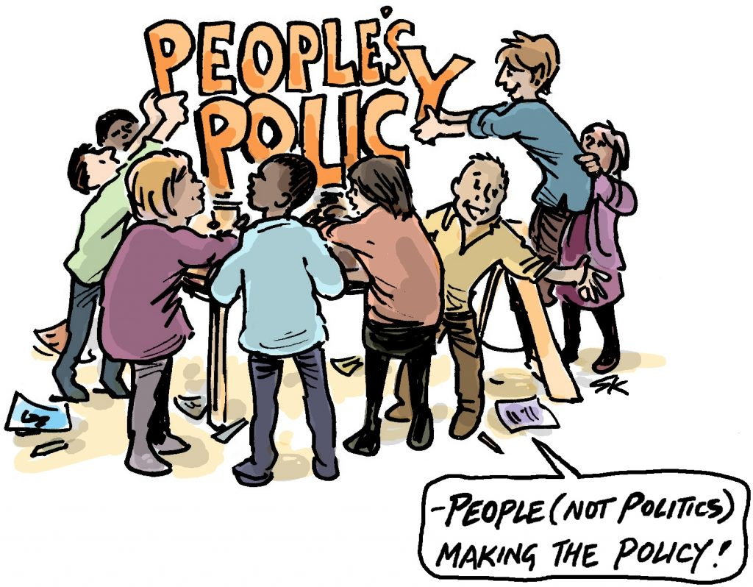
2. statute law
Passage of bills through parliament to create statute laws
Bills are draft laws that are examined and modified by Parliament
Only once is goes through the stage and been signed by ____ it becomes law
In order for legislation to be legitimate in a democracy, it must be seen to…
Allow for wide-ranging input from outside and within parliament
Be part of the mandate of a popularly elected government / or arise from a widely debated issue
Be subject to effective scrutiny in its passage through parliament

Slide 14
The functions of Parliament
At various times the roles of parliaments have included:
Initiating, debating and approving changes to statute law
Appointing and dismissing the executive (the government) and the individual executive members (Ministers)
Approving expenditure by the executive and scrutinizing the detail of administration
Representing the interests of individual citizens, electorates and majority will, as reflected in election results
Providing a forum for the debate of political issues
Acting as a court to judge anyone, parliamentarian or ordinary citizen alike, who breaches parliament’s won rules
Providing a focus for the political socialization for all citizens, and acting as a training ground for future executive members

Slide 15
The value of legislation
Legislation is the passage of bills through parliament to create statute law
Bills are draft laws that are examined and possibly modified by parliament
Only when a bill has passed ALL required parliamentary stages AND been ‘signed into law’ by the head of state, does it become an enforceable statute
Legislation is the main way in which democratic changes can be accomplished in the community, enabling society to adapt to new political, social and economic circumstances
For legislation to be seen as legitimate in a democracy it MUST be seen to:
Allow for wide-ranging input from outside and within parliament
Be part of the mandate of a popularly elected government or arise from a widely debated issue
Be subject to effective scrutiny in its passage through parliament

Slide 16
ROLES OF LEGISLATION
Bills can be classified by their roles:
One significant role of legislation is to enact new government policy. This is public policy legislation
Second, a type of Bill is remedial legislation – needed to overcome specific problems (i.e. problem exposed by court decision)
Third, governments must pass financial legislation to raise revenue and finance expenditures (appropriation Bills)
Parliament can pass subsidiary OR delegated legislation that gives authority for government departments and subordinate authorities to create legally binding regulations (discussed later)

Slide 17
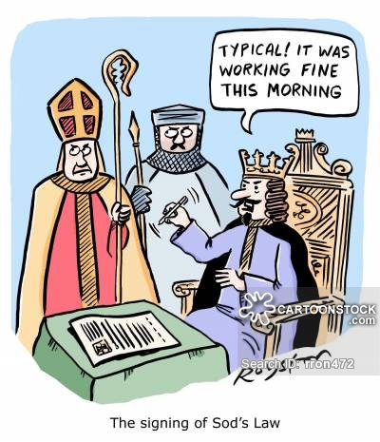
IDEAS FOR LEGISLATION
An effective democracy creates opportunities for wide-ranging participation by citizens in the initiation of legislative ideas
Where do ideas for new legislation come from?
Government part policy
Pressure group activity
Public opinion, media reports, academics
Public service advice
Commissions and other bodies set up by the government
Review by law reform groups
Individual parliamentarians
Parliamentary committees
Court decisions that reveal anomalies in the law

Slide 18
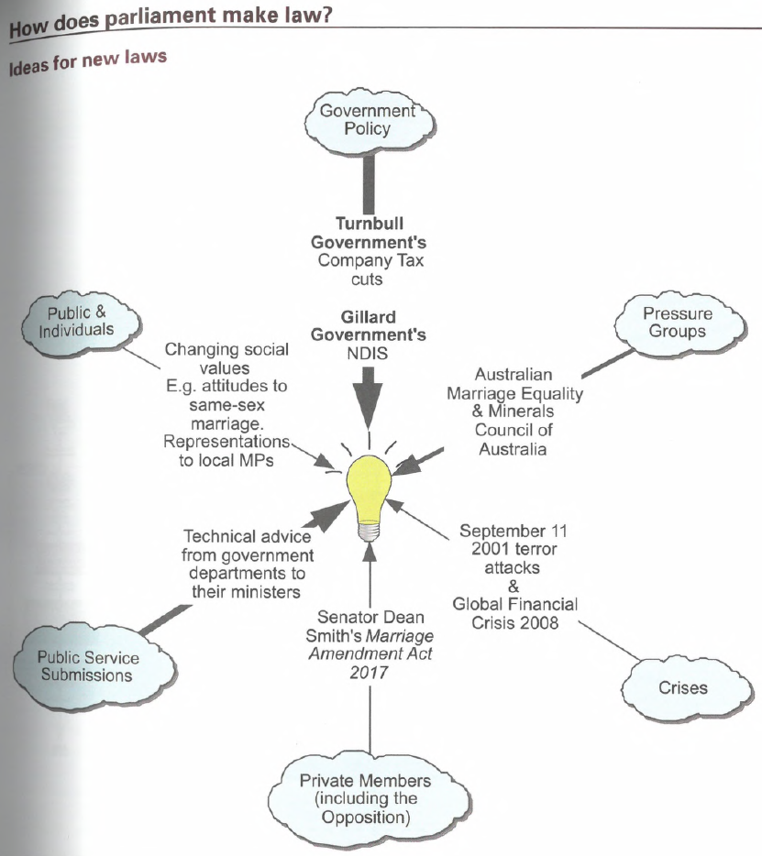
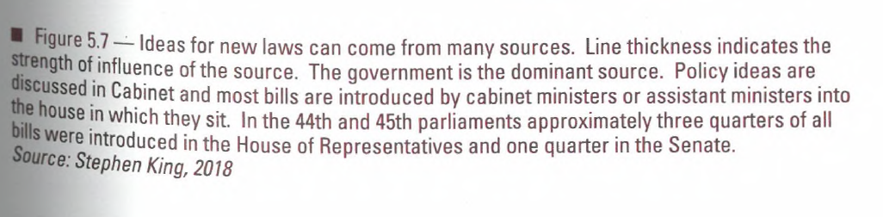

Slide 19
Private Senators’ & Members’ Bills
The right to propose legislation is NOT restricted to the government of the day…i.e. The Minister of X
Any senator or member of the House of Representatives may introduce a bill and, in the Senate, a private senator’s bill is dealt with in EXACTLY the same way as a government bill
While comparatively few private senators’ and members’ bills are agreed to by both houses, some significant proposals have become law as a result of private senators’ and members’ initiatives

Slide 20


SYLLABUS DOT POINT (EXAMINABLE MATERIAL)
Types of law made by parliament and subordinate authorities
Legislative process and the Commonwealth level

Slide 21
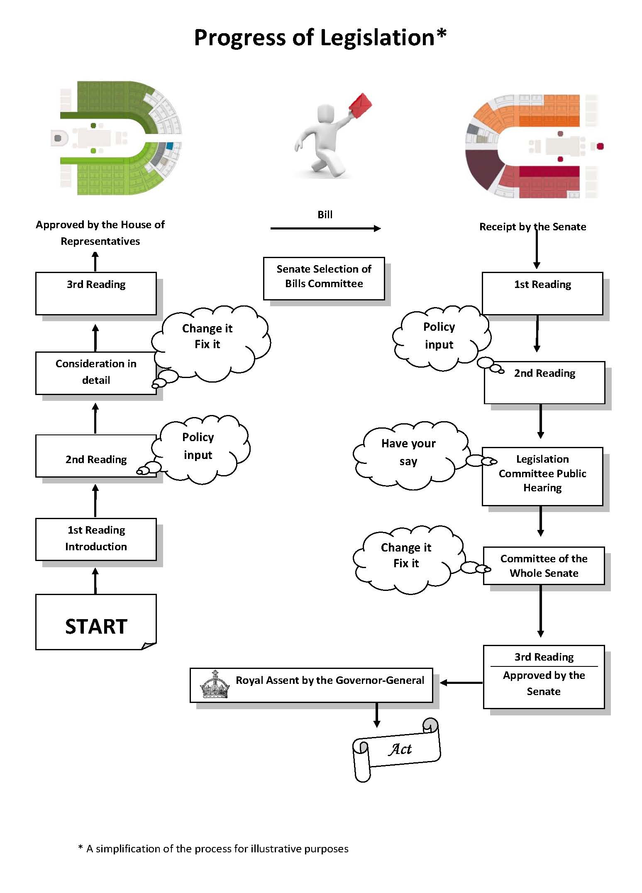
Legislative Process
https://www.youtube.com/watch?v=VPTRDsdn6dM

Slide 22
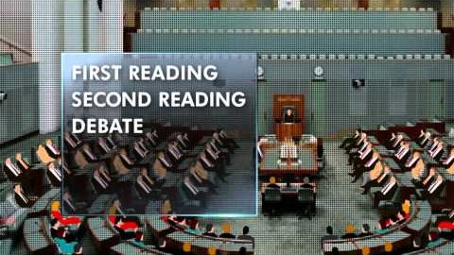

Slide 23
Initiation
Initiation = the before stage = the development of an idea into a bill
Between the conception of an idea to be implemented through legislation and the introduction of a bill to Parliament, there are extensive consultative and approval processes, described in the Legislation Handbook published by the Department of the Prime Minister and Cabinet
New ideas for legislation can arise from a variety of sources. These include:
Government party policy
Pressure group activity
Public opinion, media reports, outside experts
Public service advice
Commissions, summits and other bodies set up by the government
Review by law reform groups
Individual parliamentarians
Parliamentary committees
Court decisions that reveal anomalies in the law
Note: An effective democracy creates opportunities for wide ranging participation by citizens in the initiation of legislative ideas

Slide 24
Initiation
MOST government bills require the approval of Cabinet
When Cabinet has approved the proposal in principle, the bill is drafted by lawyers within the Office of Parliamentary Counsel, in accordance with instructions about the detailed matters to be included in the bill prepared by the responsible minister’s department (drafting instructions)
The department is also charged with writing the explanatory memorandum which is a PLAIN ENGLISH outline of the bill in BROAD TERMS, followed by a clause by clause description of the details of the bill
This provides members of Parliament AND the public with a guide to interpreting the bill
Proposed bills are listed on the Notice paper of the House
Note: Non-financial bills can be initiated in BOTH the lower house and the upper house

Slide 25
Introduction to Parliament
When a bill is ready to be introduced to Parliament, copies are printed so that they may be widely available once the bill is in the public domain
Until its introduction, a bill is subject to conventions of confidentiality which protect the privacy of the deliberations of government
After introduction, however, bills are public documents and are available in electronic form through the parliament House Bills and Legislation webpage, as are copies of current laws passed by the Federal Parliament
Most bills are introduced first in the House of Representatives because most ministers are there – BUT bills may also be introduced first in the Senate, perhaps because the responsible minister is a senator or because the House of Representatives is not sitting at the time

Slide 26
The First Reading
New business in Parliament generally occurs only after notice of it is given
A minister responsible for a bill will normally give notice the day before he or she intends to introduce a particular bill
This is a formal procedure called giving a notice of motion
When a motion is agreed to by the originating house…the bill is formally introduced and read a first time
First reading = there is usually no debate on the bill’s first or introductory reading

Slide 27
The Second Reading
The debate which occurs before a bill is read a second time represents the major policy debate on the bill
It is opened by the minster responsible for the bill – OR in the case of private senator or member’s bill, by the senator or member sponsoring the bill
The minister’s second reading speech describes the principle of the bill and the government’s purpose in proposing it
The minister is followed in the debate by opposition and other government speakers who have an interest in the bill
Senators and members may speak only once in the debate on the second reading, for up to either 20 or 30 minutes in accordance with the relevant standing orders

Slide 28
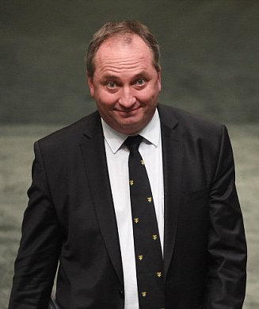
The Second Reading
The Second Reading = is when the Minister responsible for the area that the bill covers speaks in detail about the INTENT of the legislation
The Second Reading speech of the Minister has a particular legal significance in the application of the law to a specific case in the courts. If the words of an act DO NOT make its meaning clear…then the Minister’s Second Reading speech can be used as a guide to its intentions…so no pressure on the Minister!!!!

Slide 29
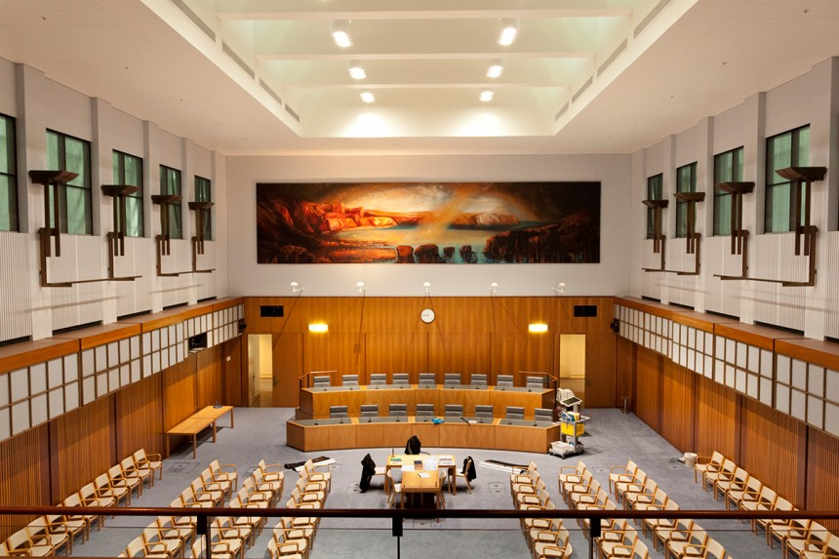
House Committee
Public inquiry into the bill and reporting back to the House
NOTE: For non-controversial bills this stage is by-passed

Slide 30
Consideration of in detail (HOR)
Members discuss the bill in detail, including any changes to the bill
In this stage amendments are proposed, debated AND voted on
If the bill is particularly controversial, it may be referred to a smaller committee of the parliament for review and further comment
These committees are known as select or standing committees
Once the contents of the bill are finalized, the next legislative process takes place
NOTE: For non-controversial bills this stage is by-passed

Slide 31
The Third Reading
In the Third Reading the WHOLE bill, with or without amendment, is put to the vote
There may be further debate but that is not always the case
As most legislation is introduced into the House of Representatives / Legislative Assembly, the majority government is usually able to ensure that the legislation passes all stages with relatively little difficulty
From time to time, a party may become the government without holding a majority of seats in the lower house…this situation is called a hung parliament…in this case, bills can only be passed with the support of independent or minor party MPs

Slide 32
Presentation to the Other House
A bill that has been passed in the House of Representatives / Legislative Assembly now goes to the Senate / Legislative Council where the same steps are followed
This can mean that the passage of legislation can be delayed and frustrated by upper houses that often seek amendments to the legislation before accepting it
Senate referral: The Senate may refer the text of the bill to a Senate committee for inquiry this can happen while the bill is in the House

Slide 33
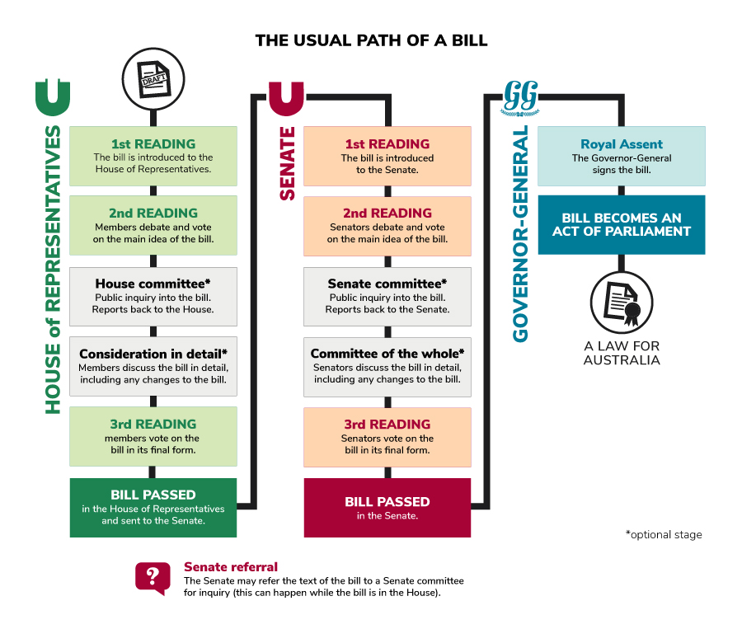


Slide 34
First & Second Reading
First Reading
The bill is introduced to the Senate
Second Reading
Senators debate and vote on the main idea of the bill
Optional Stages
Senate committee
Public inquiry into the bill and reporting back to the Senate
Committee of the whole
Senators discuss the bill in detail, including any changes to the bill

Slide 35
Detailed consideration
Following the second reading, or agreement to the bill in principle, each house considers the bill in detail, although this stage is often dispensed with, by agreement, in the House of Representatives
In the Senate, this stage is called committee of the whole
Amendments not moved by the government have a much greater chance of success in the Senate where the government does not usually enjoy a party majority as a result of the system of voting (proportional representation )
Any amendments made by the Senate MUST, however, be agreed to by the House of Representatives
The aim is for both houses to agree to the bill in identical terms so that it can then become law

Slide 36
Detailed consideration
The House of Representatives has a second, parallel chamber, called the Federation Chamber, to consider legislation and certain other types of business
The second reading debate and consideration in detail of non-controversial bills or bills over which there is agreement may occur in the Federation Chamber, presided over by the Deputy Speaker
Bills may be amended in the federation Chamber; any disagreement must be reported to the House for resolution
The process is then repeated, with appropriate variations, in the other house

Slide 37
Bills and Committees
The House of Representatives selection Committee and the Senate Selection of Bills Committee routinely consider whether bills should be referred to committees for inquiry and report
The House Committee reports its determinations to the chamber, while the Senate Committee makes recommendations which the Senate may then adopt
Bills may also be referred to committees by either chamber or by the relevant minister to House and joint committees

Slide 38
House Committees
Parliamentary committees are one mechanism the House uses to keep a check on the activities of the Government
Because they have extensive powers to call for people, including public servants, and documents to come before them, committees can thoroughly investigate questions of government administration and service delivery

Slide 39
Disagreements between the houses
When the two houses DO NOT initially agree on the contents of a bill, it is usual for negotiations to continue…
Amendments may be made or alternative amendments proposed until acceptable compromise is reached
Very occasionally, the impasse cannot be broken and a bill is laid aside and not proceeded with
A disagreement between the two houses can trigger a simultaneous dissolution of both houses

Slide 40
Disagreements between the houses
A double dissolution leads to a general election for BOTH houses
The most recent double dissolution was in 2016 when the two houses could not agree on several Industrial Relations bills
The conditions to be satisfied for a double dissolution are set out in section 57 of the Constitution
Briefly…if the senate fails to pass a bill agreed to by the House of Representatives and, after a minimum of three months has elapsed, again fails to pass the same bill to which the House of Representatives has again agreed, the Prime Minister may advise the Governor-General to dissolve both Houses of Parliament
IF, after the general election, the same bill is again passed by the House of Representatives but fails to pass the Senate, a joint sitting of both Houses may be held
Note: There has been only one joint sitting of this kind since 1901 = in 1974, six bills triggered a double dissolution and were considered at a joint sitting on 6 and 7 August 1974
On that occasion, the government’s majority in the House of Representatives was sufficient to compensate for its lack of a majority in the senate and the bills were passed by both Houses sitting as one

Slide 41
Royal Assent & Proclamation
One of the final stages in the legislative process is assent to a bill by the Governor-General on behalf of the Queen
Under the Constitution, the Governor-General may assent to a bill or without assent, but in practice a bill passed by both houses is always assented to
The Governor-General may also propose amendments to bills, but these must be returned to the houses for their agreement
If the houses do not agree, the bill is submitted again for assent in its original form
This kind of amendment is usually confined to minor drafting errors discovered only after the bill has passed both houses
Once assented to, a bill becomes an Act of Parliament and is given an Act number

Slide 43

Money Bills (APPROPRIATION BILLS)
The powers of the two houses to initiate and amend bills are identical EXCEPT in relation to bills that impose taxation or appropriate money
Section 53 of the Constitution provides that such bills may originate ONLY in the House of Representatives
Bills which impose taxation or appropriate money for the ordinary annual services of government may not be amended by the Senate
Thus if the senate wishes to amend such a bill, it must request the House of Representatives to make the amendment
When this occurs, the bill is not read a third time in the Senate until the House advises it has made the quested amendment or, in the case of the House declining to make the amendment, until agreement between the houses has been reached

Slide 45
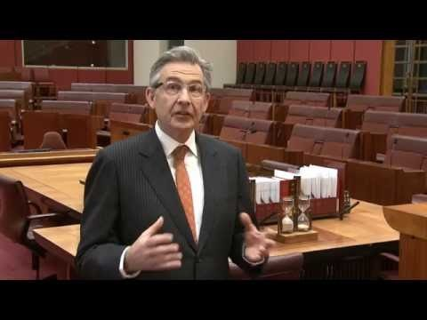
Summary

Slide 46

SYLLABUS DOT POINT (EXAMINABLE MATERIAL)
Types of law made by parliament and subordinate authorities
Legislative process and the Commonwealth level

Slide 47
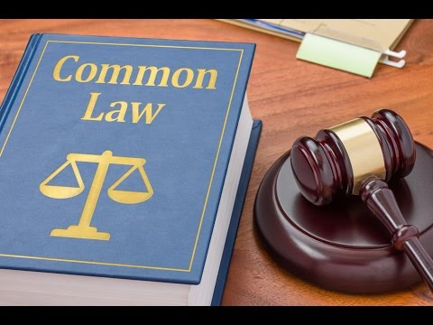
3. COMMON LAW
Common law = judge made law
Courts make decisions on cases that come before them, it generally involved 2 parties who are in dispute about the meaning of law and how it should apply to them.
Courts resolve disputes by adjudicating:
The specific facts of the case (the evidence)
The law which applies in the particular case
In most cases there will be existing law that applies to the case
However, in cases where no law exists, courts can create new common law to close the gap in the law.
Note: if Parliament is unhappy with this law or how courts interpret laws, they can pass an Act to abrogate (override) a courts decision.
Parliament = superior to courts
Read page 111

Slide 48
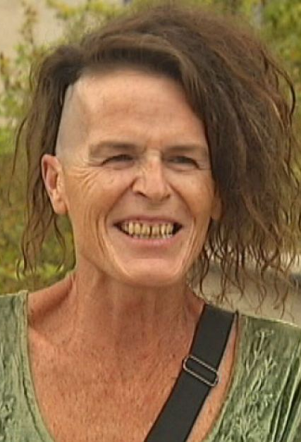
CASE EXAMPLE (COMMON LAW) Norrie ‘new sex’ example NSW Registrar of Births, Deaths and Marriages v Norrie [2014]
Norrie was born with male genitals, had surgery to become a female, but post-surgery there still remained ambiguity about her gender
2009: she sought to be registered as a non-specific sex under the Births, Deaths and Marriages Registration Act 1995 (NSW)
Registrar decided the act was strictly binary (male or female)
Norrie went to NSW Administrative Decisions Tribunal, her case was rejected
Norrie went to the Court of Appeal, and the judgement was in her favour
NSW Registrar for BDMR went to the High Court
The High Court found that whilst the Act does only allow for the male or female sex, the binary classification does not apply to everyone. They said the job of the registrar was to simply record information provided by the public, not to decide their gender for them.
This meant that there were now three recognised ‘genders’: male, female and non-specific

Slide 49
4. DELEGATED LEGISLATION
Read page 119 - 122
Parliament can pass delegated legislation
This gives authority or government departments and subordinate authorities to create legally binding regulations
‘subordinate’ means under the control or authority of another
Examples of subordinate authorities are:
Gov depts such as Dept of Home Affairs
Specialist agencies such as intelligence services (ASIO)
Statutory authorities such as Reserve Bank of Australia and Australian Electoral C.
Executive officials such as Secretary of the Dept of Defence
Ministers who are MPs appointed by the Govt to lead a gov. dept.
These are all parts of the executive branch and are subordinate to Parliament (responsible government)

Slide 50
DELEGATED LEGISLATION
Parliament writes Acts to delegate power - this is called an enabling act
An enabling act sets out the general principles of the law
However, it allows for the creation of an extensive body of specific regulations or bylaws
Example: the Local Government Act provides delegated authority for a huge range of local regulations and bylaws
Importantly – Parliament retains oversight and control

Slide 51
DELEGATED LEGISLATION
Parliament retains a range of safeguards over delegated legislation.
For example, all delegated regulations, rules and bylaws created under federal government laws must be tabled in the Senate within six days of their proclamation
The Senate’s Standing Committee on Regulations and Ordinances has the power to scrutinize delegated laws
Over 2000 pieces of delegated law are tabled in the Senate and considered by the Standing Committee each year
Delegated legislation is a necessary feature of complex societies – it takes care of ‘minor’ issues while leaving parliament to consider large issues of public policy
Delegated legislation creates complexities for the courts as well and has led to the development of the whole area of administrative law as part of statutory interpretation

Slide 52
DELEGATED LEGISLATION
Delegated legislation is vital for the operation of government – why?
Responsive, efficient
What concerns might arise from delegated legislation?
Once an enabling act is passed, executive bodies create the delegated legislation, the parliament doesn’t actually pay a direct role in the creation on legislation – thus giving powers to unelected bodies such as government departments and statutory authorities
All delegated regulations, rules and by-laws must be tabled in the Senate within 6 days of their proclamation – the Senates Standing Committee can scrutinise delegated laws – this allows the Parliament to retain some safeguards over delegated legislation
Delegated legislation is vital to the operation of government. However, delegated legislation can raise concerns about legislation and democracy
Once parliament has passed an enabling act, executive bodies actually creating the delegated legislation
The elected parliament only plays an indirect role
On the face of it this gives considerable power to unelected bodies such as government departments and statutory authorities

Slide 53
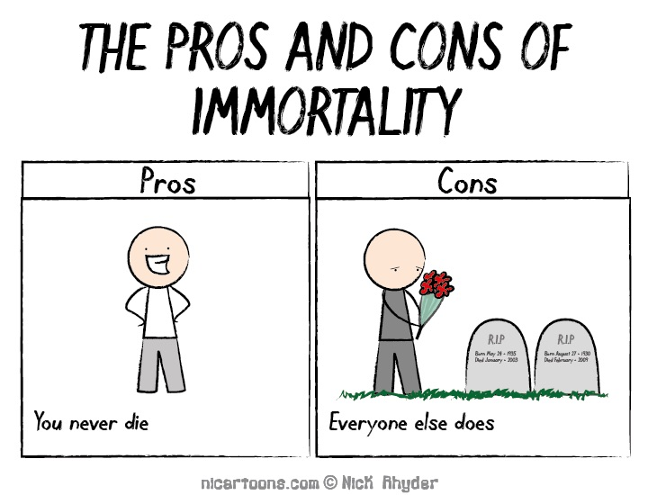
DELEGATED LEGISLATION
PROS
It is a necessary feature of complex societies
Takes care of ‘minor’ issues so Parliament can consider large issues of public policy
Experts in their field are better equipped/specialised to set specific regulations than parliamentarians
CONS
The quantity of regulations created makes it harder for citizens to know the law
Consequently, it creates complexities for the courts and has led to the development of administrative law as part of statutory interpretation

Slide 54

QUESTIONS…
Answer
Q3 a, b and c page 121

Slide 55


SYLLABUS DOT POINT (EXAMINABLE MATERIAL)
Types of law made by parliament and subordinate authorities
Legislative process and the Commonwealth level

Slide 56
Practice source

